Slide 1
CSI3344 Distributed Systems
Lecture 9
Fault Tolerance
  Contents
    9.1 Basic Issues in Fault Tolerance
    9.2 Process Group and Failure Masking
    9.3 Reliable Group Communication
    Major Points
CSI3344

Slide 2
CSI3344 Distributed Systems
Objectives
Be familiar with basic issues in fault tolerance;
Describe the principles of failure masking using process group;
Be familiar with classification of reliable multicasts.
CSI3344

Slide 3

Introduction
In distributed systems, failures may occur at any stage, e.g., during data communication, process execution, concurrency control, data replication, and so on.
  A distinguishable characteristic of distributed systems from single-process systems is fault tolerance – a feature that a (distributed) system can continue to operate in the presence of partial failure.
Redundancy is the key technique to achieve fault tolerance.
  Process group is used to realise redundancy.
  Reliable communication is needed to achieve redundancy – it provides support for communications in a process group.
CSI3344
Notes:
Use a message to Daniel
Message is written (start data communication)
Choose mail or fax (processes)
Fax to company
Daniel (not only one) Sumich (D S, not Peter S)
Department/company
Fax number
Mail to
Daniel (not only one) Sumich (D S, not Peter S)
Department/company
Address

Slide 4
9.1 Basic Issues in Fault Tolerance (1)
Terminology (1)
  Fail – a system is said to fail if it cannot meet its promises
    e.g., a component is not living up to its specifications
  Error – a part of a system’s state that may lead to a failure.
  Fault – the cause of an error
  Failure – the state/action of not functioning
    - the omission of expected/required action.
    - the result of an error/s
CSI3344
Notes:
Definitions of fault
Fault - noun
an unattractive or unsatisfactory feature, especially in a piece of work or in a person's character.
e.g., my worst fault is impatience
responsibility for an accident or misfortune.
e.g., an ordinary man thrust into peril through no fault of his own

Slide 5
9.1 Basic Issues in Fault Tolerance (2)
Terminology (2)
Fault prevention: prevent the occurrence of a fault
Fault tolerance: build a component in such a way that it can meet its specifications in the presence of faults (i.e., mask the presence of faults)
Fault removal: reduce the presence, number, seriousness of faults
Fault forecasting: estimate the present number, future incidence, and the consequences of faults
CSI3344

Slide 6
9.1 Basic Issues in Fault Tolerance (3)
Dependability
To provide services, a component may require the services from other components, e.g.,
  A component may depend on some other components
    Being fault tolerance is strongly related to dependable systems, which implies four aspects of a distributed system:
        Availability;
        Reliability;
        Safety; and
        Maintainability.
CSI3344

Slide 7
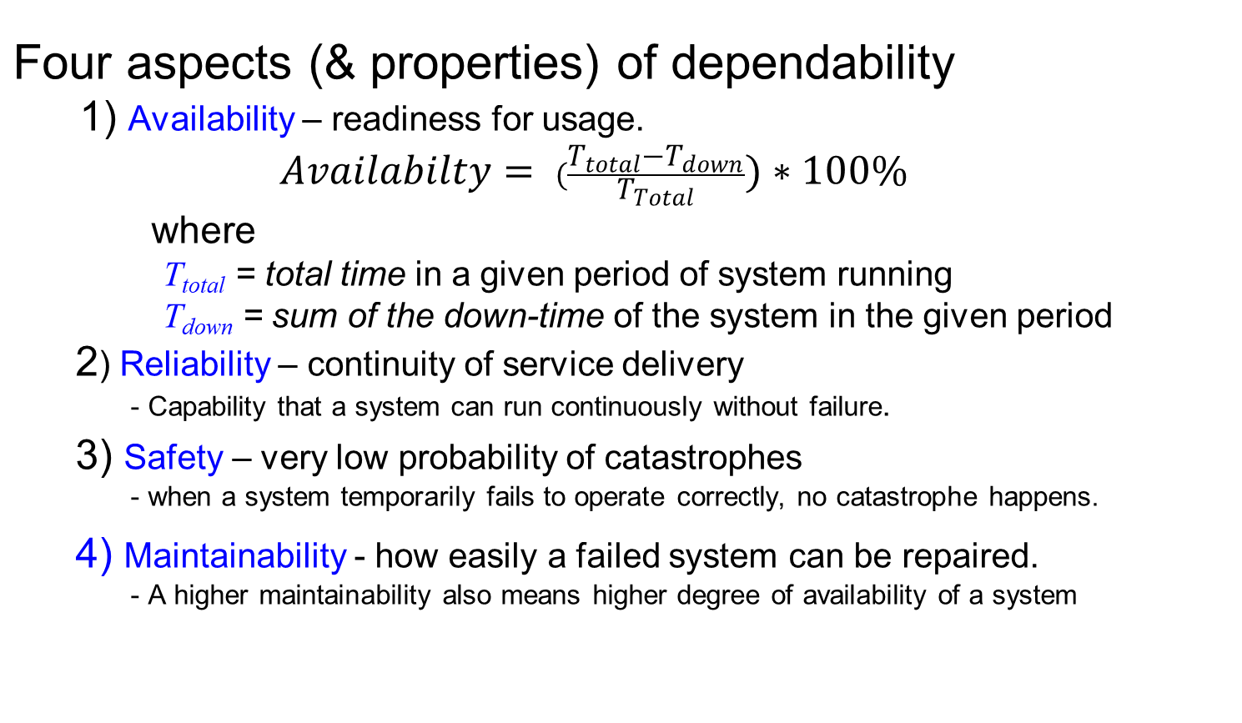
9.1 Basic Issues in Fault Tolerance (4)
CSI3344
Notes:
Reliability = Capability that a system can run continuously without failure.

Slide 8


9.1 Basic Issues in Fault Tolerance (5)
Difference between availability and reliability
Scenarios | Availability | Reliability
A system goes down one second per year. | 99.999997% | Unreliable
A system never fails but is shut down a day every 100 days for maintenance. | 99% | Reliable
A system goes down on average 6 hours in 100 days although it is shut down a day every 100 days for maintenance. | ? | ?
CSI3344
Notes:
Availability (1) = (365-1/(24*60*60))/365 = (365+1/86400)/365 = 0.999999996829…
(2) = (100-1)/100 =0.99
(3) = (100-(1+6/24))/100 = (100-1.25)/100 = 98.75%
Reliability?: not reliable
Reliability = Capability that a system can run continuously without failure.
->System provides 100% service delivery during its scheduled/promised running time.

Slide 9
9.1 Basic Issues in Fault Tolerance (6)
Fault classification
  Transient faults: refer to those faults that occur once and then disappear.
    Example: transient microwave interruption
  Intermittent faults: refer to those faults that occur, then vanish, then reappear, and so on.
    Example: loose contact on a connector
  Permanent faults: refer to those faults that continue to exist until the faulty part is repaired / replaced.
  Examples: software bugs, damaged hardware,
  power switched off
CSI3344
Notes:
Intermittent – periodic, irregular, unsteady but continued occurrence

Slide 10
9.1 Basic Issues in Fault Tolerance (7)
Failure modes
Type of failure | Description
Crash failure | A server halts, but was working correctly until it halts
Omission failure Receive omission Send omission | A server fails to respond to incoming requests - A server fails to receive incoming messages - A server fails to send messages
Timing failure | A server's response lies outside the specified time interval
Response failure Value failure State transition failure | The server's response is incorrect - The value of the response is wrong - The server deviates from the correct flow of control
Arbitrary failure or Byzantine failure | A server may produce arbitrary responses at arbitrary times
- Crash failures are least severe, arbitrary failure the worst
CSI3344

Slide 11
9.1 Basic Issues in Fault Tolerance (8)
  Problems: Clients cannot distinguish between a crashed system/component and one that is just a bit slow
    Example: Consider a server from which a client is expecting/waiting output
      Is the server perhaps exhibiting timing or omission failure; or
      Is the channel between client and server faulty (crashed, or exhibiting timing or omission failures); or
      anything else?
CSI3344

Slide 12
9.1 Basic Issues in Fault Tolerance (9)
Failure masking
  When a failure occurs, the system should be able to hide that failure from other processes so that the system can continue to operate.
Redundancy – a way of masking failure
  Failure masking can be achieved by using redundancy, i.e., putting extra resources into the system.
  Examples: backup server, replicated databases, replicated name table in DNS servers, etc.
CSI3344
Notes:
DMS – domain name services

Slide 13
9.1 Basic Issues in Fault Tolerance (10)
Example: At least two routes between any two routers in the Internet.
A
1
B
Hosts
2
or local
3
4
C
networks
5
D
6
E
Routers
CSI3344

Slide 14
9.1 Basic Issues in Fault Tolerance (11)
Classification of redundancy
  1. Information redundancy
  - adding extra bits into the transferred data so that some
  garbled bits can be restored.
    Example: noise filtering of digital signals
  2. Time redundancy
  - performing an action again (& again) when required.
    Example: email resending
  3. Physical redundancy
  - adding extra hardware and/or software to make system tolerate
  failures from both hardware components and application
  programs
CSI3344

Slide 15
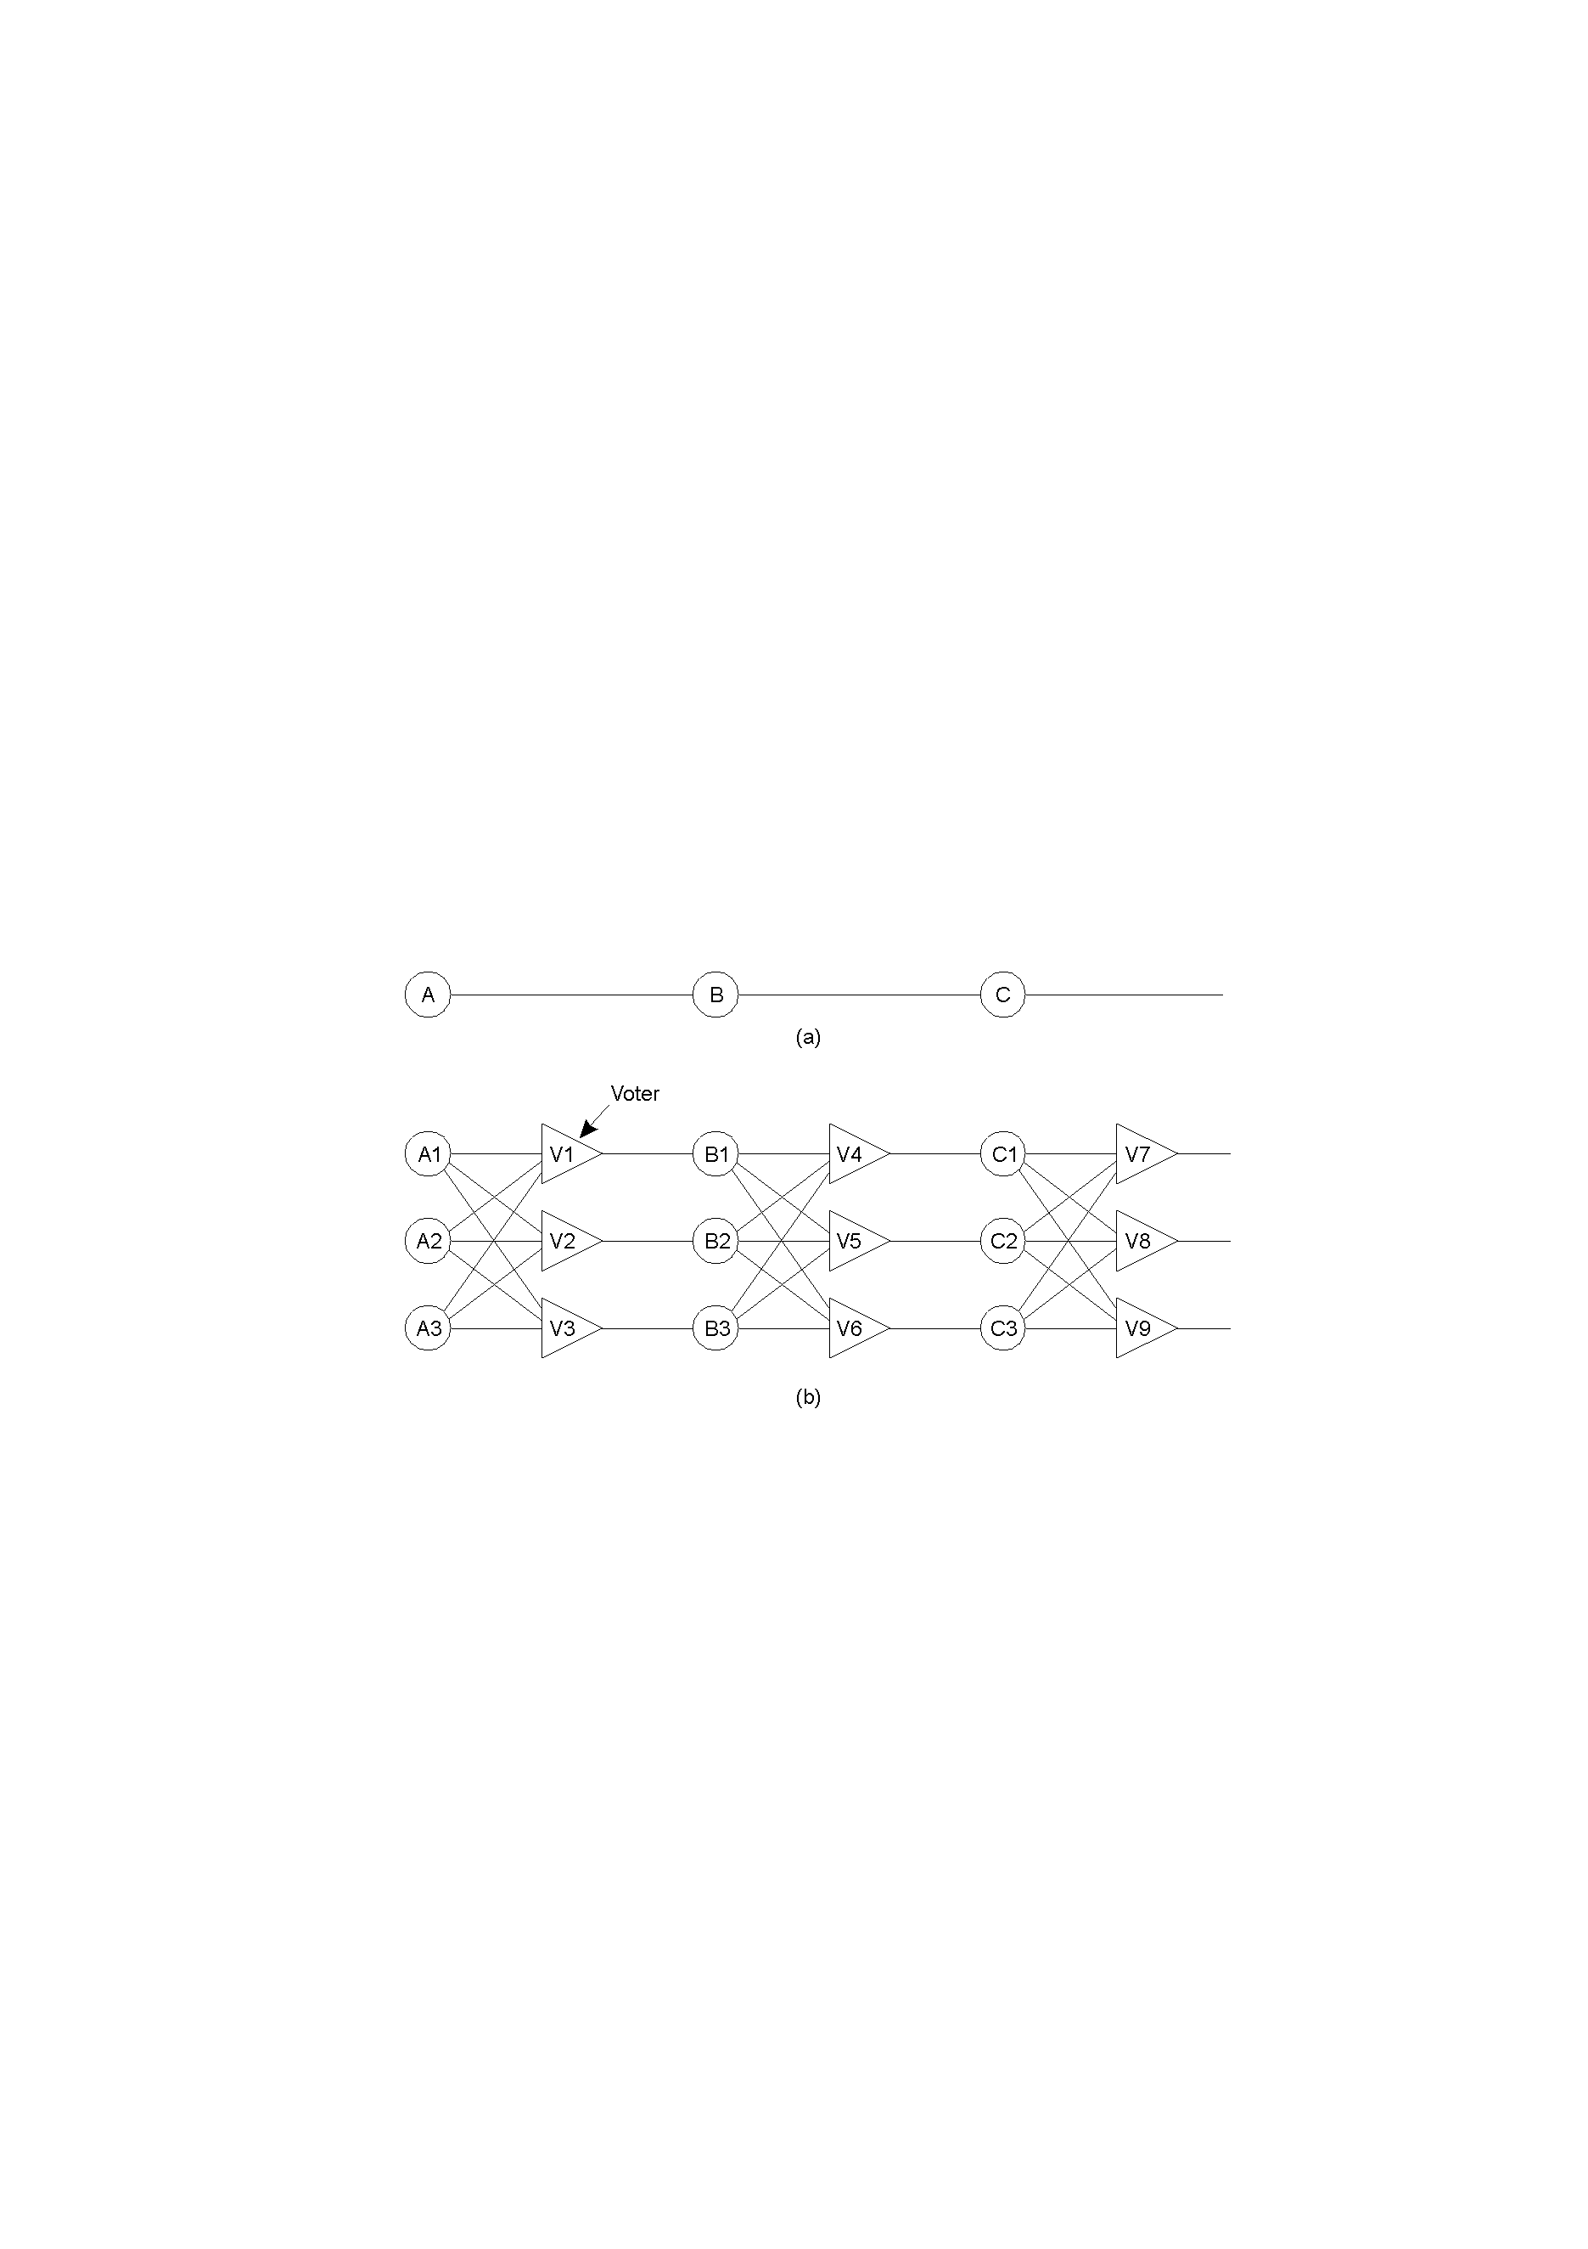
9.1 Basic Issues in Fault Tolerance (12)
Fault tolerance by physical redundancy
  Example: triple modular redundancy (TMR) circuit
Triplicated voter: 3 inputs & 1 output
if 2 or more inputs are the same, the output is equal to that inputs
if all three inputs are different, the result is UNDEFINED - N
CSI3344
Notes:
Bottom: triplicated voter: 3 inputs & 1 output
- if 2 or more inputs are the same, the output is equal to that inputs
- if all three inputs are different, the result is UNDEFINED - N

Slide 16
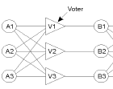


9.1 Basic Issues in Fault Tolerance (13)
Analysis (see example shown in the last slide)
    A1(T) → V1(T,F,T) → T ➔ B1
    A2(F) → V2(T,F,T) → T ➔ B2
    A3(T) → V3(T,F,T) → T ➔ B3
    B1(T) → V4(T,T,T) → T ➔ C1
    B2(T) → V5(T,T,T) → T ➔ C2
    B3(T) → V6(N,N,N) →N ➔ C3
    C1(T) → V7(T,T,N) → T ➔
    C2(T) → V8(T,T,N) → T ➔
    C3(N) → V9(T,T,N) → T ➔
CSI3344
Notes:
Suppose there are two failures:
suppose the initial input is T to A1, A2 and A3, due to failure, A2 feeds an F (instead of T), to B1 and B2, and B3, then the voters V1, V2, and V3 will still vote to T into gate B which gets correct results, T
Similarly, if both Vote V6 and C3 fails to produce correct input, the final results are still correct.

Slide 17
9.2 Process Group and Failure Masking (1)
Process group
  Several identical processes can be organised into one group to protect a system against process failures.
Basic function of process group
  When a message is sent to a group, all members of the group receive it. If one process in a group fails, some other processes can take over for it.
Features of process group
  1. Dynamic - a process can join or leave a group.
  2. Manageable - group membership can be managed.
  3. Multicast communication
CSI3344

Slide 18
9.2 Process Group and Failure Masking (2)
Example: general structure of a process group
Group address expansion
Group
Leave
send
Multicast communication
Fail
Group membership
management
Join
Process group
CSI3344
18

Slide 19
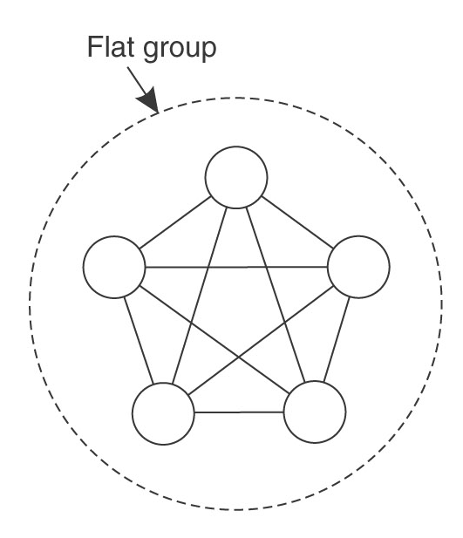
9.2 Process Group and Failure Masking (3)
Internal structures of groups
  1. Flat groups
  In a flat group, all the processes are equal, and all decisions are made collectively by all members.
  Good: no single point of failure.
  Bad: decision making involves
  all members, which may
  lead to delay and overhead.
CSI3344

Slide 20
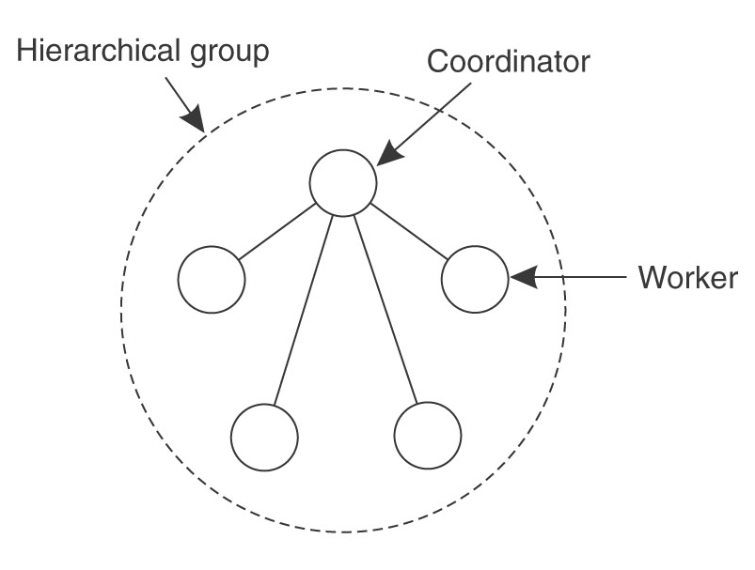
9.2 Process Group and Failure Masking (4)
Internal structures of groups
  2. Hierarchical groups
  In a hierarchical group, one process is the coordinator who solely makes all the decisions in the group, and all others are workers.
  Good: quick decision making
  and efficient.
  Bad: a single point of failure
  (i.e., the coordinator).
CSI3344

Slide 21
9.2 Process Group and Failure Masking (5)
Approaches in managing group membership
  1. Group server
    Management of group membership (joining, leaving and deleting) is handled by a separate server.
    Good: efficient, easy to implement.
    Bad: a single point of failure - group server.
  2. Distributed group membership
    Group members are distributed in a system and communicate with each other by message multicasting.
    Good: no single point of failure.
    Bad: slow decision making.
    hard to distinguish a crashed process from a left process.
CSI3344

Slide 22
9.2 Process Group and Failure Masking (6)
How to replicate processes in a group
  1. Primary-based replication → hierarchical groups
  Replication is made using primary-backup protocols.
  A (fixed) primary acts as the coordinator for all write operations.
  When the primary crashes, backups elect a primary as the new coordinator.
Requests and replies
Primary
Backup
C
FE
PS
BS
Client
Front ends
Service
C
FE
BS
Backup
CSI3344
Notes:
FE: front end

Slide 23
9.2 Process Group and Failure Masking (7)
How to replicate processes in a group
  2. Replicated-write protocols → flat groups
  Replication is made using active replication protocols.
    Replicated processes are distributed in a system.
    All processes make decision collectively
RS
C
FE
RS
FE
C
RS
CSI3344

Slide 24
9.2 Process Group and Failure Masking (8)
How many replicas are needed to achieve a certain degree of fault tolerance?
  A system is said to be k-degrees of fault tolerance if it can survive faults in k identical processes/components and still provide service correctly.
  For non-arbitrary failures, to achieve k-degrees of fault tolerance,
  k +1 replicas are needed.
Example:
    Process/component Degree of fault tolerance Replicas needed
    (k) (k+1)
    Server 1 2
    Database 2 3
    Program 3 4
    Printer 4 5

Slide 25
9.2 Process Group and Failure Masking (9)
For a system with arbitrary (or Byzantine) failures, to achieve k-degrees of fault tolerance, 2k +1 replicas are needed
(vote is needed to decide the majority in this case).
Example:
    Process/ Degree of fault Replicas needed Comparison
    component tolerance (k) (2k+1) <(2k+1)
    Server 1 3 (2T:1F) 2 (1T:1F)?
    Database 2 5 (3T:2F) 3 (1T: 2F)?
    4 (2T: 2F)?
    Program 3 7 (4T:3F) 5 (2T: 3F)?
    6 (3T: 3F)?
    Printer 4 9 (5T:4F) 7 (3T: 4F)?
    8 (4T: 4F)?
CSI3344

Slide 26
9.3 Reliable Group Communication (1)
Atomic multicast for group communication
  Communication in a dynamic group (leaving, joining and deleting) should ensure that all active members receive the same message at a specific moment (all) but nothing if any membership change occurs during transmitting-receiving (nothing).
  Two issues:
  Dynamic membership control – group view
  Atomic multicast – all-or-nothing
CSI3344

Slide 27
9.3 Reliable Group Communication (2)
Dynamic membership control – the group view
  Group view is a delivery list distributed to each group member (process) in the group.
  Control point – each member should have the same group view for a message to be accepted.
Procedure of atomic multicast (1)
  If no change in group membership
    Pi checks group view before sending a message;
    Pi sends the message to other group members;
    All members receive the message and react to sender;
    If reactions from all members are ‘normal’, all members finally commit.
CSI3344

Slide 28
9.3 Reliable Group Communication (3)
Procedure of atomic multicast (2)
  If change occurs during communication
    Pi checks group view before sending a message;
    Pi sends the message to other group members;
    All members receive the message and react to sender;
    If one member responded improperly (just crashed or left, etc.), all members will notice it and the action aborts;
      Update the group view;
      Repeat steps 1 – 3;
    If reactions from all members are ‘normal’, all members finally commit.
Principles of Distributed Systems

Slide 29
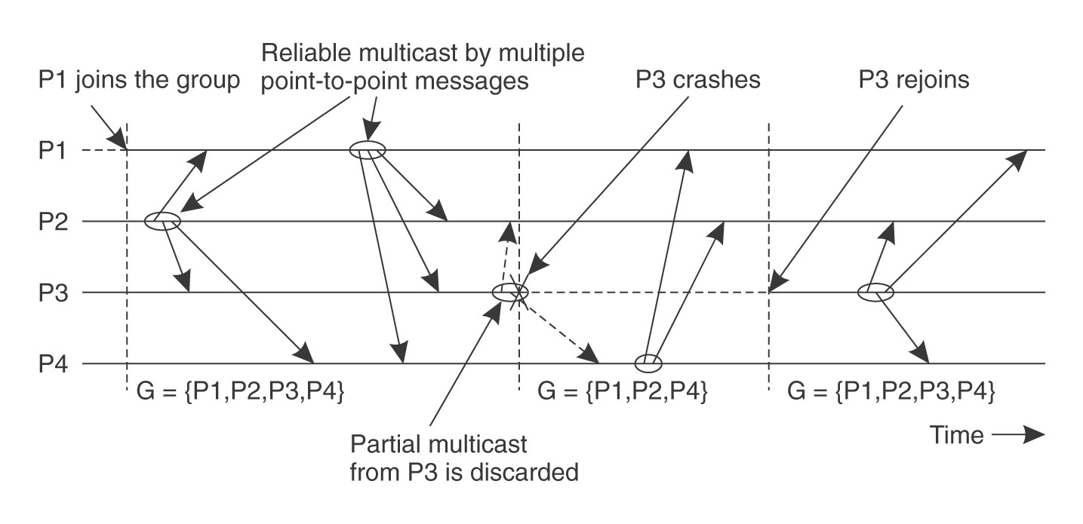
9.3 Reliable Group Communication (4)
Principle of atomic multicast
  Example
(G: group view held by every member)
CSI3344

Slide 30
9.3 Reliable Group Communication (5)
Commonly used reliable multicasts (1)
  Unordered multicast
    Messages may be received by different processes in different order
Process P1 | Process P2 | Process P3
sends m1 | receives m1 | receives m2
sends m2 | receives m2 | receives m1
Figure 8-14: three communicating processes in the same group. The ordering of events per process is shown along the vertical axes.
CSI3344

Slide 31
9.3 Reliable Group Communication (5)
Commonly used reliable multicast (2)
  2. FIFO-ordered multicasts
  The communication layer is forced to deliver incoming messages from the same process in the same order as they have been sent
Process P1 | Process P2 | Process P3 | Process P4
sends m1 | receives m1 | receives m3 | sends m3
sends m2 | receives m3 | receives m1 | sends m4
 | receives m2 | receives m2
 | receives m4 | receives m4
Figure 8-15: Four processes in the same group. With two different senders, and a possible delivery order of messages under FIFO-ordering multicasting.
CSI3344

Slide 32
9.3 Reliable Group Communication (6)
Commonly used reliable multicasts (3)
  3. Causal-ordered multicasts
  It delivers messages so that potential causality between deferent messages is preserved.
    - If m1 causally precedes another message m2, regardless of whether they were multicast by the same sender, the communication layer at each receiver always delivers m2 after (it has received and delivered) m1.
Process P1 | Process P2 | Process P3
sends m1 | receives m1 | receives m1
sends m2 | receives m2 | receives m2
CSI3344

Slide 33
9.3 Reliable Group Communication (6)
Commonly used reliable multicasts (4)
4. Total-ordered multicast
  Messages are delivered in the same order to all group members
  Can be unordered, FIFO, or causally ordered
Process P1 | Process P2 | Process P3 | Process P4
sends m1 (1.1) | receives m1 | receives m1 | sends m3 (2.1)
sends m2 (1.2) | receives m2 | receives m2 | sends m4 (2.2)
 | receives m3 | receives m3
 | receives m4 | receives m4
CSI3344

Slide 34
Major Points
Dependability of distributed systems
Difference between availability and reliability
Classification of redundancy
How many replicas are needed to achieve a certain degree of fault tolerance?
Commonly used reliable multicasts
Reading Guide
  DSPP: 8.1, 8.2.1-2, 8.4.3
Advanced Reading Guide
  DSPP: 8.4.1-2, 8.5
CSI3344

